Slide 1


Microsoft Certified Data Engineer
NHS Dorset Lead Data Engineer
British Civil Service
American Silicone Valley Software Company
AG: Largest RMG Denim Manufacturer in the world
MSC in Data from UK University, Bachelor from Australian University

Slide 2
Cultivating Data Engineering Excellence in Healthcare

Slide 3
Agenda
Defining Strategic Vision and Aligning Data Architecture with The Vision
01
Data Engineering Strategy
Data Engineering Solution and Architecture
Developing a Data Culture that Delivers High Performing
Data Team
02
Key Elements of Data Engineering Culture
Recruitment Strategy
System Thinking and Communities of Practice

Slide 4
Defining Strategic Vision and Aligning Data Architecture with The Vision
01

Slide 5
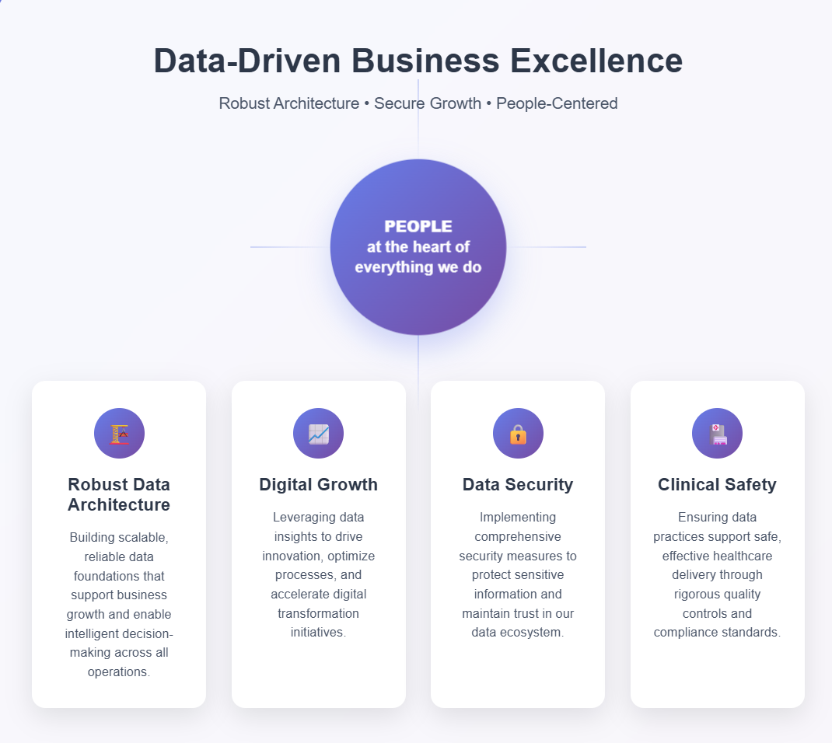
Strategic Vision for Data Engineering to Align with Hospital Vision
Facilitating a data driven business practice though a robust data architecture that prioritises digital growth, data security, clinical safety by putting people at the heart of everything we do.

Slide 6
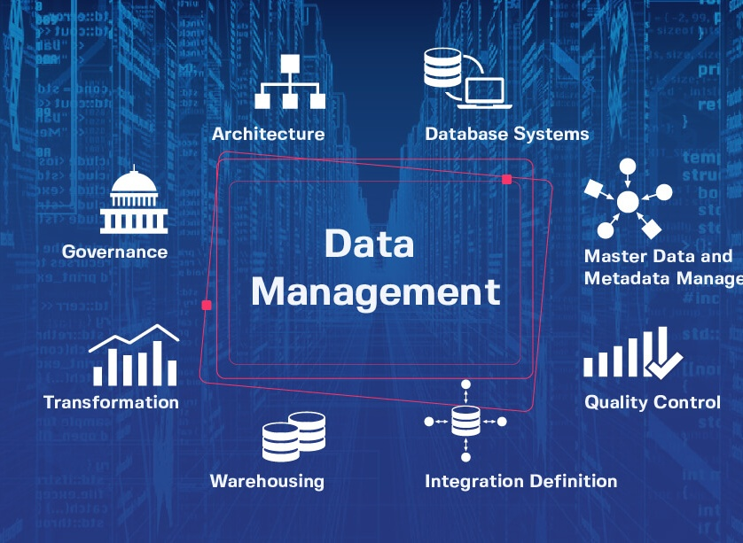
GOALS of Perfectly Functioning Data Platform and Architecture
reliability, scalability, usability, automation, and value delivery

Slide 7


Assumptions and Budget Considerations
Azure and SQL Heavy
Power BI Eco Heavy
Not strict requirements but Easy to adopt if-
Already using SQL Server, Synapse
Using ADF as an integration tool
Team’s expertise only in T-SQL
Ready to pay for Azure Resources
Does not have any Fabric SKU purchased
Not strict requirements but Easy to adopt if-
Very Small number of data engineers
Completely new solution, little experience with Azure Eco system
A lots of Power BI Developer
Members keen on continuous learning
Does not have any Fabric SKU purchased
Ready to quickly upskill and learn new modern tools

Slide 8


Data Engineering Architecture
(if you do not have one already)
Data Warehouse Architecture
Sandbox
Bronze (LH/DW)
Silver (LH/DW)
Gold (DW)
DATA ENGINEERING
Blob
SQL Servers
ERPs
ADF/
SSIS
Deployment Pipeline (CICD) Git Integration on Azure DevOps YAML Pipeline to call Fabric Rest API to auto deploy from Environments
ETL logics in .sqlproj or in Notebook
ADF Orchestration through Metadata Database
Test/Live
Bronze
Silver
Gold
Blob
SQL Servers
ERPs
ADF/
SSIS
Deployed through CICD pipeline
Code sits in Git Repo (Azure DevOps Repos)
Create a Feature branch > Develop > PR Reviewed > Merge with Collab Branch > > DevOps CICD YAML: Checks Code > Deploy to TEST > Once Approved, Deploys to LIVE triggered by Push on LIVE Branch
Hot Fixes: HotFixes on the Live Branch > CICD YAML creates backup of Live Branch with Hotfix.

Slide 9
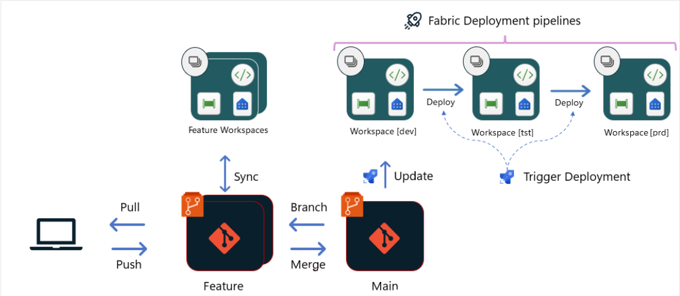
Power BI Development Only
Power BI Development
.pbip
Git Repo
Deployment Pipeline (CICD) Git Integration on Azure DevOps YAML Pipeline to call Fabric Rest API and PowerShell to auto deploy from Git and Stages

Slide 10
Best Practices for Data Engineering
Logging Database for ETL
Visualise ETL health on a Power BI report
SCD type 2 logic used whenever possible
Clustered Columnstore Indexing on Patient Fact Tables or Large Fact Tables
Purview to ensure Data Quality – scanning, alerts etc.
Auto Copy of Hotfix branch using Azure DevOps pipeline – ensure Main Branch Backup
All the Basic SQL DML, DDL or any SQL keywords will be Uppercase
Pascal Case for Column Names ( e.g. UserID, PatientName)
Clear and elaborated Naming Convention
Avoiding Merged Into Statement for Performance boost, Use insert/update/delete
If using Databricks: Creating Index on LH frequently Joined columns. E.g. “OPTIMIZE patients ZORDER BY (patient_id)”
If using Databricks: Partitioning on LH on Low Cardinality Column. Like Months or Regions.
If using Databricks: use of DLT to handle SCD type to logic

Slide 11
Best Practices for Power BI
Filter early:
Apply filters and transformations as early as possible in the query to reduce the amount of data processed.
Incremental Refresh
Datamarts:
For complex Power Query and Power Bi transformation, use datamarts on the sql server or DW. If you do use native query, then get a datamart done by data engineers.
Turn off default visual interactions if not needed.
No to calculated tables;
No Dataflow;
Get a datamart in place. Use Lakehouse or DW to bring data in.
Row Level Security in Power BI

Slide 12
Key Elements of Data Culture
All 3 Key Elements (Scene: Dashboard development for Mental Health Services Provider)
1. Collaboration and Communication: Matsudaira, K. (2019). -- Sibbir organizes a joint planning session
-- Collaborating directly with the domain experts to understand which data fields are most important,
-- Arranging drop location, standup to remove blocker
2. Knowledge Sharing: Jamshed, S., & Majeed, N. (2019). -- Junior engineers struggles to optimize a complex SQL query that’s slowing down the ETL pipeline.
-- Sibbir walks them through an efficient indexing strategy, and documenting the tip on dev wiki
3. Emotional Intelligence: Jamshed, S., & Majeed, N. (2019). -- As a lead of the Sibbir always schedules well-being call with his team members 1:1
-- Finds out one member going through emotional struggles
-- Therefore, assigns less urgent pieces of work until he has sorted his mental health

Slide 13
Recruitment Strategy
Recruitment Objective: Technical, Values Driven, Commitment to continuous Development.
1. Interview and Assessment: Rai, S. (2024). -- Assess on real-life problem solving through take home assessments, helps testing for Architectural Thinking, Rai, S. (2024); Karam, S., Nagahi, M., Dayarathna, V., , J., Jaradat, R., & Hamilton, M. (2020).
-- Assess System Thinking Skills – Scenario based questions on implementing cloud solutions; Opportunity to assess on cultural fitness and technical depth of unittesting, cloud infrastructure, faster shipment. Allal-Chérif, O., Aránega, A., & Sánchez, R. (2021).
2. Fair Competition: Jamshed, S., & Majeed, N. (2019). Jacob, B., Rockoff, J., Taylor, E., Lindy, B., & Rosen, R. (2016). -- Clear job description; avoiding ambiguous role statements; Only include technologies currently used or likely to be implemented.
-- Fair competition without biases. Giving Referred and non-referred applicants' equal opportunity. Networking is not the core skill for DE.

Slide 14
Communities of Practice
“Cultivating a practice of shared learning is vital more than ever now. AI is a key board shortcut on steroid.”
Monthly Dev Hours:
-- Organising monthly discussion on improving the existing development and delivery process.
-- Reusable templates, sharing CICD practice knowledge
2. External CoP: Jamshed, S., & Majeed, N. (2019). -- Participate and deliver at National Data Engineering Groups
-- Cross-Trust Collaboration and learning exchange
3. Keeping existing Engineers: Jamshed, S., & Majeed, N. (2019). -- Constantly looking for opportunities to improve the data tech stack, Implementing cutting edge solutions to keep employees motivated.
-- Budget to develop existing team and implement that cutting edge tool with existing team member.
-- Ensuring continuous development and learning support is provided through in-house training support or protected learning window for vendor certifications such as Microsoft DP700/ Snowflake Core Certification/ Databricks Certifications

Slide 15
References Provided
Varonis Sobers, R. (2024, September 13). 157 cybersecurity statistics and trends [Updated 2024]. Varonis. Retrieved June 8, 2025, from https://www.varonis.com/blog/cybersecurity-statistics somerfordassociates.com
Forbes Advisor Brooks, C. (2024, June 5). Alarming cybersecurity stats: What you need to know in 2024. Forbes. Retrieved June 8, 2025, from https://www.forbes.com/advisor/education/it-and-tech/cybersecurity-statistics/ forbes.com
McKinsey (QuantumBlack) Assur, N., & Rowshankish, K. (2022, January 28). The data‑driven enterprise of 2025. McKinsey & Company. Retrieved June 8, 2025, from https://www.mckinsey.com/capabilities/quantumblack/our-insights/the-data-driven-enterprise-of-2025
Matsudaira, K. (2019). How to Create a Great Team Culture (and Why It Matters). Queue, 17, 5 - 13. https://doi.org/10.1145/3317287.3323993.
Jamshed, S., & Majeed, N. (2019). Relationship between team culture and team performance through lens of knowledge sharing and team emotional intelligence. J. Knowl. Manag., 23, 90-109. https://doi.org/10.1108/JKM-04-2018-0265. Rai, S. (2024). INNOVATION IN RECRUITMENT IN TALENT ACQUISITION: A STUDY ON TECHNOLOGIES AND STRATEGIES ADOPTED FOR TALENT MANAGEMENT IN IT SECTOR. INTERANTIONAL JOURNAL OF SCIENTIFIC RESEARCH IN ENGINEERING AND MANAGEMENT. https://doi.org/10.55041/ijsrem32666.
Allal-Chérif, O., Aránega, A., & Sánchez, R. (2021). Intelligent recruitment: How to identify, select, and retain talents from around the world using artificial intelligence. Technological Forecasting and Social Change, 169, 120822. https://doi.org/10.1016/J.TECHFORE.2021.120822.
Karam, S., Nagahi, M., Dayarathna, V., , J., Jaradat, R., & Hamilton, M. (2020). Integrating systems thinking skills with multi-criteria decision-making technology to recruit employee candidates. Expert Syst. Appl., 160, 113585. https://doi.org/10.1016/j.eswa.2020.113585.
Jacob, B., Rockoff, J., Taylor, E., Lindy, B., & Rosen, R. (2016). Teacher Applicant Hiring and Teacher Performance: Evidence from Dc Public Schools. Organizations & Markets: Motivation & Incentives eJournal. https://doi.org/10.1016/j.jpubeco.2018.08.011.

